Slide 1

Multimodal Mental Health Analysis
DEEP THINKERS
MADHUMITHA NATESAN
PRIYADRSHINI BALASUBRAMANIAN
SANA AMBREEN
LIKITHA REDDY METTU

Slide 2

Introduction
Anxiety and Depression are a severe mental health condition affecting millions of people throughout the world.
It is important to detect early in order to provide effective treatment.
In this project, the DAIC dataset is employed to identify depression on basis of interviews with patients.
We used a Multimodal learning system using audio, video, and text for mental health classification.
Address mental health diagnosis gaps using objective, scalable ML models

Slide 3

Business Understanding
Mental health conditions such as Anxiety and Depression are often underdiagnosed and undertreated.
Traditional clinical assessments are manual, subjective and time-consuming.
Motivation:
1 in 8 people globally experience mental disorders.
Automation can enhance early screening and assist clinicians.
Objective:
Build a Machine Learning system to classify depression using multimodal interview data (text, audio, video).

Slide 4

Dataset overview
DAIC-WOZ Dataset: DAIC-WOZ (Distress Analysis Interview Corpus)
It consists of 190 participants who are all undergoing semi-structured clinical interviews.
Interviews were conducted with a virtual interviewer “Ellie”.
Modalities:
Audio (.wav, COVAREP, Formant)
Video (CLNF: AU, Gaze, Pose)
Text : Participant transcripts (per-question)
PHQ-8 score mapped to 3-class labels: Depressed and Not Depressed

Slide 5
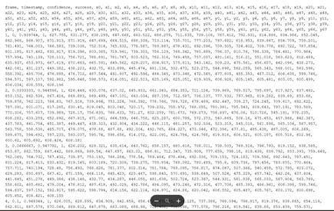
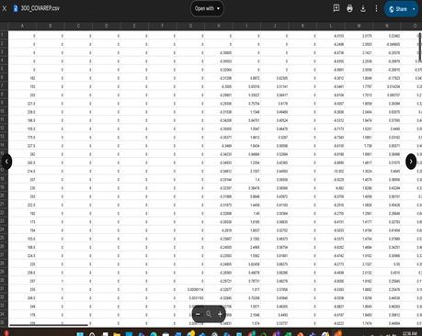
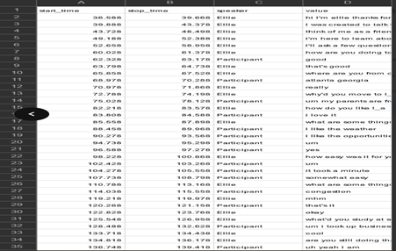
Data Preparation
Loaded PHQ-8 metadata for depression scoring.
Extracted features from folders (COVAREP, FORMANT, TRANSCRIPT, CLNF, Gaze).
Label Creation:
PHQ-8 ≥ 10 → Depressed, otherwise Not Depressed
Final feature size after preprocessing: 3690 Features
Text Processing with BERT:
Used SentenceTransformer: all-MiniLM-L6-v2
Converted interview responses to sentence embeddings.
Aggregated embeddings per participant.

Slide 6
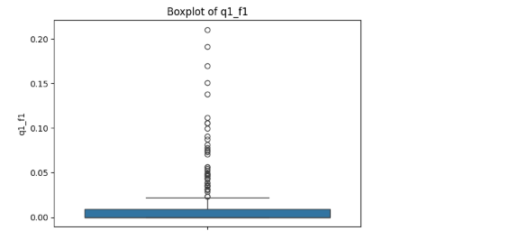
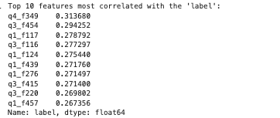
Data Cleaning
Data Cleaning:
Handled missing modalities by dropping and imputing.
Normalized/standardized features with Standard Scaler.
Removed constant-variance features that don’t contribute to model learning.
Clipped extreme outliers to improve model robustness.
Visualized outliers using boxplots to identify abnormal feature distributions.
Checked label distribution to address class imbalance

Slide 7
Model Architecture
We picked a simple neural network because it can learn patterns from our 100 features and is small enough so as not to overfit when we only have about 200 samples.
We built two models: one trained on original data, the other on synthetic data generated using SMOTE.
SMOTE was applied to generate synthetic samples for the depressed class, helping to balance the dataset and improve model fairness.
Both followed the same preprocessing and were trained using the same feed-forward neural network architecture.
Raw Data
Feature Selection
Original Data
Top 100 features selected
Train/Test Split
Robust Scaler
Fed into Neural Network
SMOTE Applied (for synthetic model only)

Slide 8
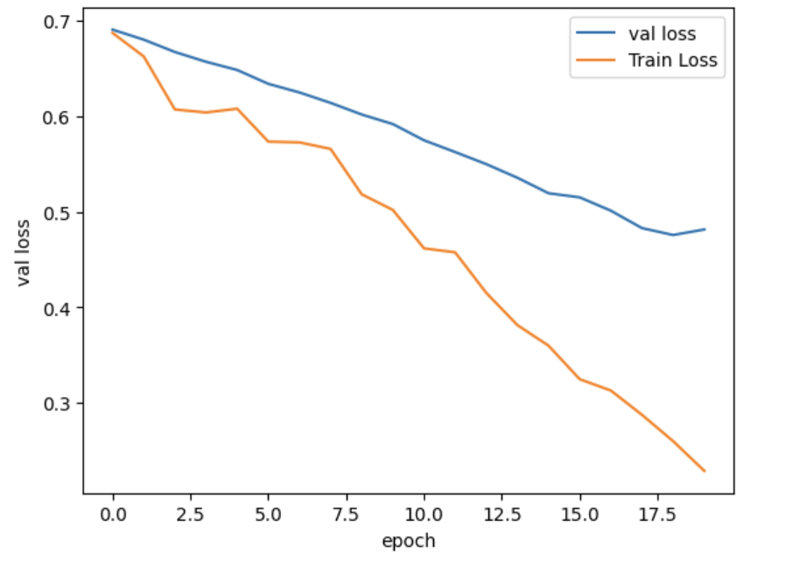
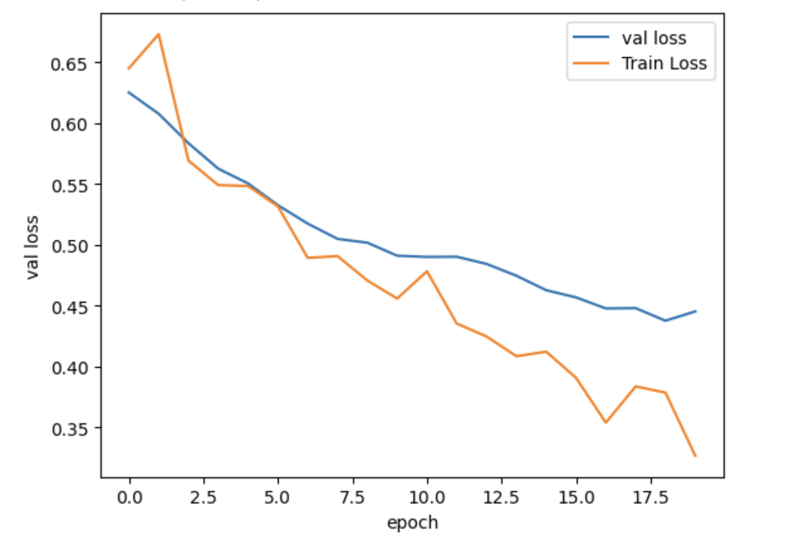
Training & Validation Loss: Original vs. SMOTE-Augmented Model
SMOTE-Augmented Model
Both models show a consistent decrease in training and validation loss, indicating effective learning.
There is no sharp gap between the training and validation loss indicating no severe overfitting.
The SMOTE-augmented model exhibits a smoother and more stable loss curve.
Original Data Model

Slide 9
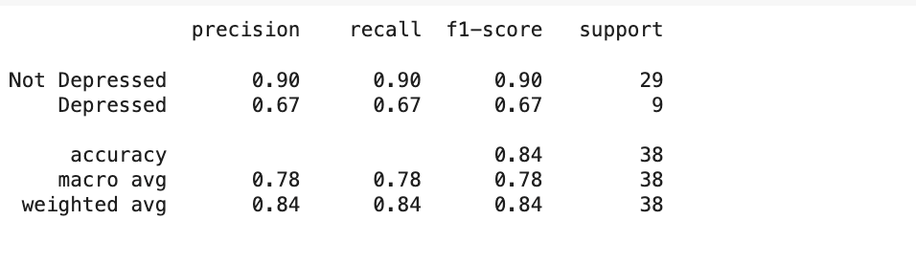
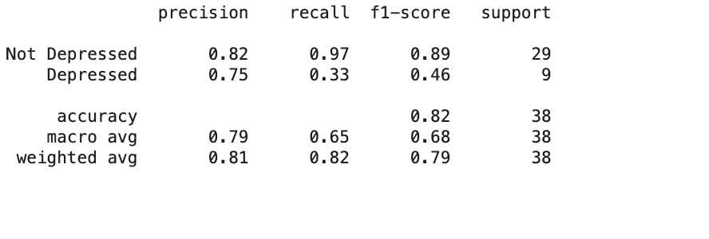
Model Performance
SMOTE-Augmented Model
Achieved an accuracy of 84%, with more balanced performance between the majority and minority classes.
Recall for the “Depressed” class improved to 0.67, enhancing detection of minority cases.
Indicates better generalization and fewer false negatives, which is critical in mental health screening.
By using SMOTE, our model recognized depression cases better while keeping accuracy high.
Original Data Model
Accuracy is 82%, but recall for the “Depressed” class is low at 0.33.
Strong bias toward the majority class (Not Depressed) with 97% recall, increasing the risk of missing depressed individuals.
The F1-score for the Depressed class is 0.46, indicating weaker performance on minority cases.
SMOTE-Augmented Model
Original Data Model

Slide 10


Challenges
Multimodal Data Alignment
It was challenging to sync the audio, video, and text-specific features of each participant.
Limited Dataset Size
The dataset included only 189 participants, which limits the ability to generalize results to larger populations
Class Imbalance
Dataset was highly imbalanced with lower number of not depressed cases.
Large Number of Features
There were around 3000+ features which increased the risk of overfitting

Slide 11
Impact & Use Case
Clinical Decision Support: Help psychologists with real-time, data-driven mental health assessments.
Early Detection: Allow proactive screening in schools and workplaces to detect mental health issues early on.
Therapist Augmentation: Offer automated, explainable second opinions to support clinical judgment.
Empowered Decision-Making: Promote trust through interpretable AI models that support informed care.

Slide 12

Future Work
Model Improvements
Implement real-time deployment with streaming support.
Engineer additional features like speaking rate, pitch variation, or facial micro-expressions.
Deployment & UI
Build a console-based UI to interact with the model.
Create a live demo version for clinical environments.

Slide 13
Future Work – Vision & Applications
Scalability & Data Expansion
Extend the dataset using E-DAIC for greater generalization.
Address data imbalance and label noise in future versions.
Patient-Facing Tools
Develop a mobile/web app for self-assessment.
Enable live-streaming input (video/audio/text) for real-time analysis.
Design patient feedback mechanisms to understand mental states via simple Q&A.

Slide 14

Conclusion
Developed a complete end-to-end multimodal machine learning system.
Successfully integrated audio, video, and text modalities for depression detection.
Achieved better accuracy through a feed-forward neural network combined with a stacked meta-learner.
Our approach highlights advancing how multimodal AI systems can play a valuable role in mental health diagnostics.

Slide 15

Recommendations
Generalize the dataset by expanding it with the E-DAIC corpus.
Enhance label quality through expert-verified annotations.
Focus on model interpretability to support real-world clinical decision-making.
Develop a patient-facing app to improve usability and accessibility.

Slide 16
Thank You!

